Slide 1

Marketing
2015

Slide 2
Positioning
LaSalle Solutions
LaSalle Solutions is a leader in lifecycle asset management, providing best-in-class processes and tools to help customers acquire and track and manage their technology assets and associated maintenance contracts
LAMP
The industry benchmark in helping users manage information, processes and reporting around IT assets, lease financing and maintenance contracts to enable optimized efficiencies and successful sustainable planning.

Slide 3
Positioning: The LaSalle Difference
Depth of expertise
Superior customer service
Trusted Advisor
Dedicated service team with decision making authority
Customer-driven approach and personalized solutions
Stability: The Company has been serving customers for over 30 years. LaSalle Solutions still does business with its first customer.
Commitment to continuous improvement of processes, services, tools and resources
As a value-added reseller (VAR), LaSalle Solutions is the customer’s single source for managing assets, contracts and processes

Slide 4

Customer Driven
“Thanks again for all you do to make our life easier” – Global Financial Company
“The Value Add LaSalle provides has reduced my work load by 20%, allowing me to be more proactive to the customers needs.” – Major Supplier
“When doing our Gartner Review, I found that what took us 3 months in the past I was able to produce in 20 minutes.”- Large Financial Services Company
“I only had time to take a quick look at LAMP this morning and during the training session, but I am impressed with what I see so far. The system is very responsive and well designed to help me get my work done.“ -National Association
Voicemail from Michael Bruce

Slide 5
In The News
LaSalle Achieves Cisco Master Security Specialization January 6, 2015
LaSalle on TV December 31, 2014
LaSalle Recertifies Cisco Gold December 30, 2014
LaSalle Solutions Expands to New Headquarters November 25, 2014
LaSalle Solutions Re-Certifies Cisco Master Collaboration Specialization October 21, 2014
LaSalle Solutions Unveils New Website October 7, 2014
LaSalle Solutions Recognized by Cisco for Excellence in Customer Satisfaction July 31, 2014
LaSalle Solutions Named to the Monitor 100 List July 16, 2014
LaSalle Solutions Named to CRN’s 2014 Solution Provider 500 List July 10, 2014
LaSalle Solutions to Showcase LAMP at Cisco Live 2014 May 19, 2014
LaSalle Solutions Recognized as Cisco EnergyWise Suite ATP Partner May 15, 2014
LaSalle Solutions Recertifies for Advanced Specializations from Cisco April 23, 2014
LaSalle Solutions Wins Cisco Services US Partner of the Year Award April 1, 2014
Go to www.elasalle.com/news to read all LaSalle Solutions News
#LaSalleinthenews

Slide 6

Recognition
Cisco Services Partner of the Year, US - 2014
Cisco one of 30 partners to be Gold Certified with Master Collaboration & Master Security Specializations
Cisco Customer Satisfaction Excellence Award 39 consecutive quarters: as of October 2014
Cisco Central Region Services Partner of the Year – 2008, 2011, 2012 and 2013
TMC 2014infoTECH Spotlight Data Center Excellence Award
Ranked on the CRN Solution Provider 500 List – 2012, 2013, 2014
Channel Partners 360 Award 2013
Ranked on the Monitor 100 Top Equipment Finance and Leasing Companies in the United States 2012 - 2014
Go to www.elasalle.com/recognition to see all LaSalle Solutions Recognition & Awards

Slide 7



Cisco Engineering Accreditations
Authorizations
Master Unified Communications Specialization
Accelerated TelePresence Try and Buy
Cisco Capital Financing
Cisco Certified Refurbished Equipment
Cisco TelePresence Video SMB Program
Customer Satisfaction Excellence
GPN Resale Host
Global Resale Agent
Indirect Service Discount Promo
Registered Developer
Regular Try and Buy
UCS Capacity Assurance - Try and Buy
ATP - Cisco TelePresence Video Advanced
ATP - Identity Services Engine
Certifications/Specializations
Master Unified Communications Specialization
Advanced Borderless Network Architecture Specialization
Advanced Collaboration Architecture Specialization
Advanced Data Center Architecture Specialization

Slide 8
Cisco Recognition
Cisco Central Region Services Partner of the Year – 2008, 2011, 2012 and 2013
Cisco Customer Satisfaction Excellence Award 39 consecutive quarters: as of October 2014
Ranked on the CRN Solution Provider 500 List – 2012, 2013, 2014
TMC Data Center Excellence infoTECH Spotlight Award 2014
Ranked on the Monitor 100 Top Equipment Finance and Leasing Companies 2012 - 2014
One of 30 Cisco Partners that are Gold Partner with both Master Collaboration & Master Security Specializations
Go to www.elasalle.com/recognition to see all LaSalle Solutions Recognition & Awards

Slide 9



Goals for 2015
Awareness
Increased Thought Leadership Communications
Increased use of appropriate social marketing tools
Increased visibility
Growth
Leads for sales

Slide 10

Targets, Channels and Vehicles
Partners, Existing Customers, Prospects, Your targets???
Regional vs National push
Manufacturer co-marketing programs (Cisco, Violin Memory, etc.)
Vehicles
Direct marketing (electronic and direct mail)
Video (YouTube, direct email, etc.)
Websites (Industry sites, bloggers, LaSalle website, microsite, etc.)
Events (tradeshows, conferences, seminars, sponsorships, etc.)
Social Media (LinkedIn, YouTube, facebook, etc.)

Slide 11
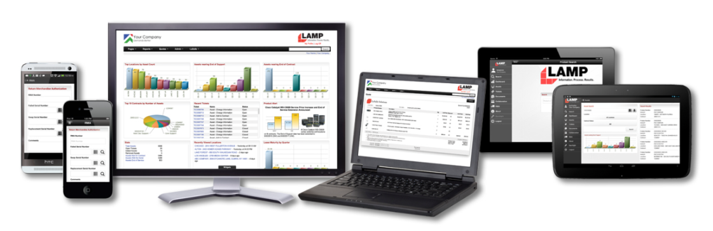

Programs
Awareness
PR
Emails/Newsletters
Events / Sponsorships
Survey
Lead Generation
Emails
Events
Racing Program: TRG-AMR Sponsor
Social:
LinkedIn/Facebook/Twitter/Google+
Though Leadership: White Papers – Security, Data Center
Demand Better
Better Information. Better Process. Better Results.

Slide 12

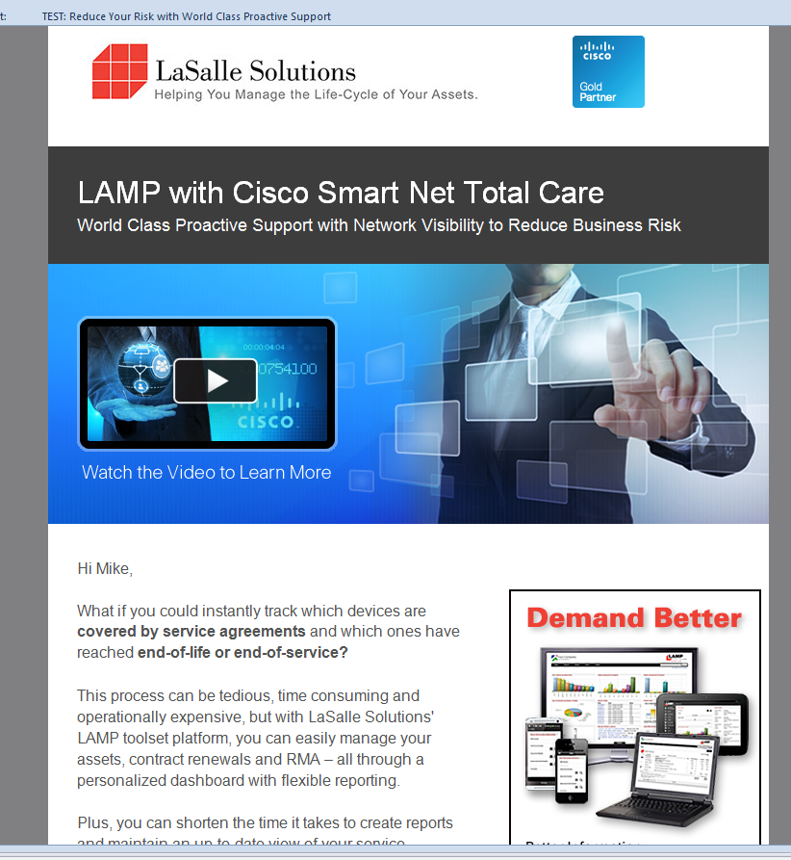
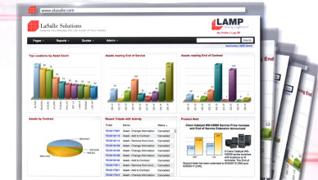


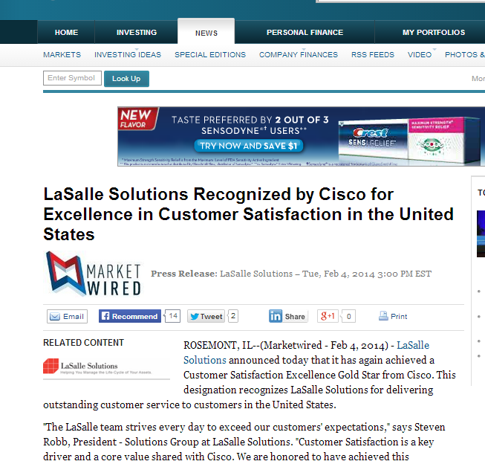


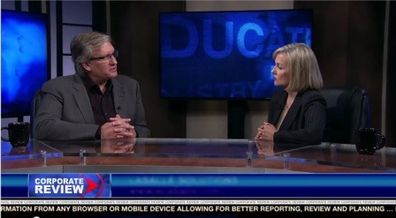

Awareness
Target: Cisco Internal
Target: Net new list
videos
Events
Referrals
PR
newsletter
Social

Slide 13

Lead Generation
Events
Direct Emails
Demand Better
Better Information. Better Process. Better Results.

Slide 14
LaSalle at the Races
IMSA TUDOR United SportsCar Cham pionship
Pirelli World Challenge
January 23-25, 2015 | Daytona Intl. Speedway | 24 Hour | Daytona, FL
March 6-8, 2015 | Circuit of the Americas |  | Austin, TX
March 21,2015 | Sebring International Raceway | 12 Hour | Sebring, FL
March 27-29, 2015 | St Petersburg |  | St. Petersburg, FL
April 17-19, 2015 | Long Beach Street Circuit |  | Long Beach, CA
April 24-26, 2015 | Barber Motorsports Park |  | Leeds, AL
May 3, 2015 | Mazda Raceway Laguna Seca | 2 Hr 45 min | Laguna, CA
May 15·17, 2015 | Canadian Tire Motorsport Park |  | Bowmanville, ON
May 29-31,2015 | Detroit Belle Isle |  | Detroit, MI
30-May-15 | Detroit Belle Isle | 100 min | Detroit, MI
June 26-28, 2015 | Road America |  | Elkhart Lake, WI
June 28, 2015 | Watkins Glen International | 6 Hours | Watkins, Glen, NY
July 25, 2015 | Lime Rock Park | 2 Hr 45 min | Lakeville, CT
July 31 - August 2, 2015 | Mid-Ohio Sports Car Course |  | Lexington, OH
August 9, 2015 | Road America | 2 Hr 45 min | Elkhart Lake, WI
August 21-23, 2015 | Miller Motorsports Park |  | Tooele, UT
23-Aug-15 | Virginia Intl. Raceway | 2 Hr 45 min | Alton, VA
August 28-30, 2015 | Sonoma Raceway |  | Sonoma, CA
September 11-13, 2015 | Mazda Laguna Seca Raceway |  | Laguna, CA
19-Sep-15 | Circuit of the Americas | 2 Hr 4S min | Austin, TX
October 3, 2015 | Road Atlanta - Petit Le Mans | 10 hours | Atlanta, GA
Events
Find out more about IMSA TUDOR
Find out more about Pirelli World Challenge
#LaSalleRacing

Slide 15
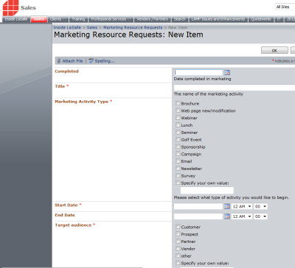



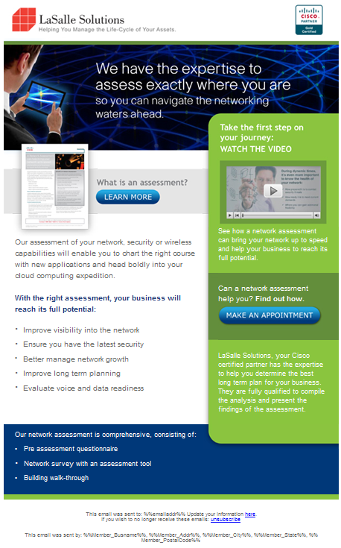

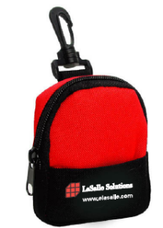
Marketing Resource Request (MRR)

Slide 16

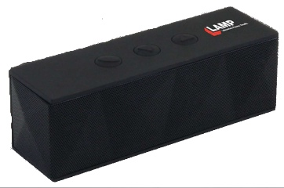
When to initiate a Marketing Resource Request (MRR)
Are you registering LaSalle to sponsor or exhibit at an event or program?
Golf event, charity, conference, lunch, happy hour, etc.
Are you hosting an event or program?
Do you want to order any giveaways or anything branded?
Do you need any marketing pieces created, printed, etc.?
thank you notes, white papers, brochures, emails, etc.
Would you like to start a lead generation email campaign? Or other type of regular communication with leads or customers?
Do you have an idea(s) for a new white paper, video, success story/ case study, marketing piece that is currently not available?
Do you have improvement ideas for any existing marketing pieces, videos, white papers, website, etc.?

Slide 17
Keep in Mind: Marketing Resource Request (MRR)
Initiate the MRR as soon as you decide to submit sponsorship, event information to partner/venue
MRRs will be reviewed and clarification may be necessary for the item to be developed/MRR to proceed.
If logos are needed – what is the file type and size necessary?
If sponsorship or event, what is the focus? Do all types of content necessary exist or need to be created? Doe the giveaway item make sense?
MRRs must be initiated with lead times in mind
Does content need to be written?
Does creative need to be developed?
Will items need to be ordered?

Slide 18
What you will need: MRR
Initiate a new MRR
You will need the following information:
What the activity/event will be (type: brochure, event, campaign, email, survey, etc.)
Opportunity/benefit (what is the purpose – awareness, sales, etc.)
dates (start/end date of activity/event)
Target audience (who is the target? customers, prospects, etc.)
Description with any more specific details (there is opportunity to attach items as well)
Estimated costs (time/money)
Success metrics (number of click thrus, emails, meetings, sale, etc.)
Is it a recurring event? (will it occur on an ongoing basis or again that you know of )
Priority (nice to do, need)
Initiate an MRR via SharePoint/”Intranet” >sales tab>lists>Marketing Resource Request
Or
SharePoint/”intranet” – left

Slide 19
What to Expect after submitting a MRR?
Initiate a new MRR
You will receive an email response from Marketing/Beth within one business day
The email will acknowledge your submission
The email may request a meeting to find out more information
The email may include specific questions to better understand your needs.
From the MRR and any follow up information a project timeline will be set
The project timeline will be followed
Beginning Q2 2014, at completion, results will be documented
Success metrics will be reviewed for future improvements
The MRR process is evolving. If you have questions or improvement ideas, please email Beth.

Slide 20
2015 Marketing Programs
Awareness
Lead Generation

Slide 21
2014 Sales and Technical Documentation
Standardization

Slide 22
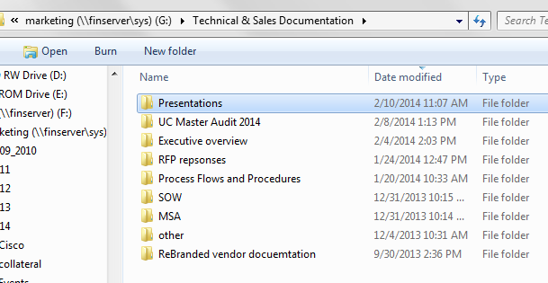
2014 Documentation Standardization
Templates on Intranet
Document “templates” available
Presentations
SOW
Proposal responses
Technical documents
Other documents
Templates on shared drive
For documentation standardization and editing assistance and questions email Beth with
Existing document, if available
Specific needs – edits, focus, customer/partner involved, etc.
Date needed (every effort should be made to provide information to Beth as soon as possible and, at least, two business days prior to need.)

